Slide 1


Air Traffic Services
Civil Aviation University of China
Civil Aviation University of China

Slide 2
Learning objectives
Objectives:
State the objectives of ATS
List the types of separation
Explain wake turbulence
Describe the criteria for the use of runway
State the five legs of an aerodrome traffic pattern
Describe the functions of an approach controller
State the objectives of Flight Information Service
State the objective of Alerting Service
State the three phases for alerting service
References:
ICAO Annex 11
ICAO Doc 9426
ICAO Doc 4444

Slide 3
Objectives of the air traffic services
prevent collisions between aircraft;
prevent collisions between aircraft on the maneuvering area and obstructions on that area;
expedite and maintain an orderly flow of air traffic;
provide advice and information useful for the safe and efficient conduct of flights;
notify appropriate organizations regarding aircraft in need of search and rescue aid, and assist such organizations as required.
ATC
FIS
Alerting Service

Slide 4
Air Traffic Control Service
Tools
Radar
VHF
Information
Traffic information
Environment information
Terrain
Weather
Output
Clearances, instructions, information
Objectives
Safety & efficiency

Slide 5
Controller Information Processing
System capability
Interface design
Stress & workload
Complexity
Automation
Feedback
Situation Awareness
Perception
of elements
in current
situation
Level 1
State of
The traffic
situation
Comprehension of Current situation
Level 2
Decision
Action
Projection of future status
Level 2
Information Processing
Mechanisms
Goals & Objectives
Expectations
Long-term
Memory stores
Automaticity
Abilities
Experience
Training

Slide 6
Types of Separation
Vertical separation
Lateral separation
Horizontal separation
Composite separation
Time separation
Distance separation
VFR separation
IFR separation (non-radar)
Radar separation
Wake turbulence separation

Slide 7
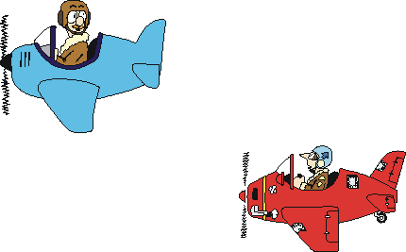
Visual Separation
For VFR flights in uncontrolled airspace
For IFR flights under certain condition
See and avoid

Slide 8

IFR separation (non-radar)
10min
Two aircraft flying on the same track, at the same level and speed:
10 minutes/5 min/3 min

Slide 9
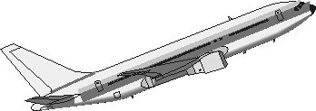
IFR separation (non-radar)
6600m
15min
6300m
15min
15min
6000m
For an aircraft changing level through the level of another on the same track, a minimum longitudinal separation of 15 min/5min

Slide 10

IFR separation (non-radar)
10min
6600m
6300m
10min
6000m
Estimated Point of passing
For an aircraft changing level to cross the level of another in reciprocal flight, the former may climb to a level above, or descend to a level below the latter 10 minutes prior to the estimated point of passing

Slide 11
IFR separation (non-radar)
6600m
10min
6300m
10min
6000m
Estimated Point of passing
one aircraft may cross the level of another 10 minutes after the estimated point of passing

Slide 12


IFR separation (non-radar)
For two aircraft on crossing tracks at the same level, a longitudinal separation of 15 min/10 min
15 min

Slide 13

IFR separation (non-radar)
50 km
VOR
≥15º
VOR separation

Slide 14

IFR separation (non-radar)
50 km
NDB
≥30º
NDB separation

Slide 15

IFR separation (non-radar)
20 km
DME
40 km
DME
20 km
DME separation

Slide 16
IFR separation (non-radar)
6600m
20 km
6300m
20 km
20 km
6000m
DME
DME separation

Slide 17



Radar Separation
Where radar control is implemented, radar separation minima shall be :
(1) 6 kilometers in approach control domain, and
(2) 10 kilometers in area control domain
6 km
APP 6 km
ACC 10 km

Slide 18
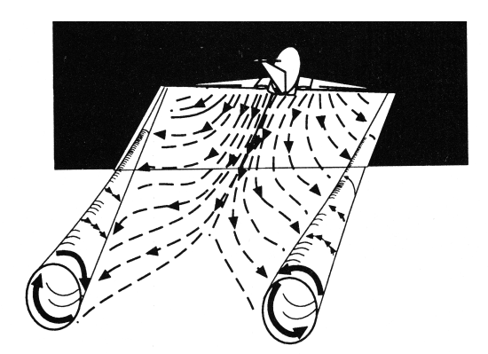
Wake turbulence Separation
Wake turbulence separation shall be applied to avert the effect of wake turbulence

Slide 19
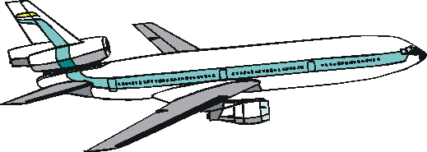
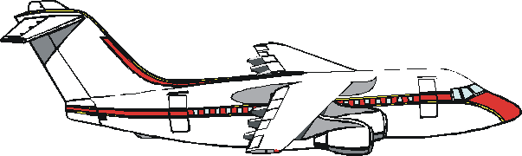
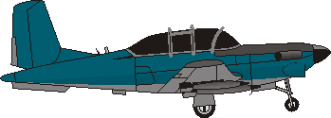
Wake turbulence Separation
Wake turbulence separation shall be applied between departing and departing, and arriving and arriving.
Wake turbulence separation minima is determined by maximum certificated takeoff mass.
Aircraft are classified according to their maximum certificated takeoff mass into three categories.
HEAVY: ≥ 136,000 kg
136,000 kg > MEDIUM > 7,000 kg
LIGHT: ≤ 7,000 kg

Slide 20
Wake turbulence Separation
Wake Turbulence Separation Based on Distance
Leading Aircraft | Following Aircraft | Separation Minima (km)
HEAVY | HEAVY | 8
HEAVY | MEDIUM | 10
HEAVY | LIGHT | 12
MEDIUM | LIGHT | 10
MEDIUM | HEAVY | 6
Airbus 380 |  | X + 4

Slide 21
Wake turbulence Separation
Wake Turbulence Separation Based on Time
Leading Aircraft | Following Aircraft | Separation Minima (min)
HEAVY | HEAVY | 2
HEAVY | MEDIUM | 2
HEAVY | LIGHT | 3
MEDIUM | LIGHT | 3

Slide 22
Wake turbulence Separation
The deficiency with existing Wake Turbulence Separation Minima?
How to design a dynamic WTSM system?
Better categorization
Atmospheric condition detection
Wake turbulence detection
Friendly presentation to the controller

Slide 23
Aerodrome Control
Aircraft taxiing on the taxiways
Use of the runway
Aircraft in the vicinity of the aerodrome

Slide 24
Use of the runway
A departing aircraft will not normally be permitted to commence take-off until the preceding departing aircraft has crossed the end of the runway-in-use or has started a turn or until all preceding landing aircraft are clear of the runway-in-use.

Slide 25
Use of the runway
A landing aircraft will not normally be permitted to cross the runway threshold on its final approach until the preceding departing aircraft has crossed the end of the runway-in-use, or has started a turn, or until all preceding landing aircraft are clear of the runway-in-use.

Slide 26
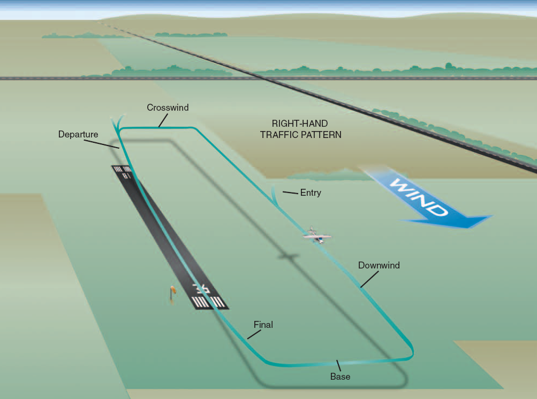
Aerodrome Traffic Circuit
Under VMC, Aircraft may follow a traffic circuit and make a landing

Slide 27
Aerodrome Traffic Circuit
Downwind
Wind
Crosswind
Base
Final
Upwind

Slide 28
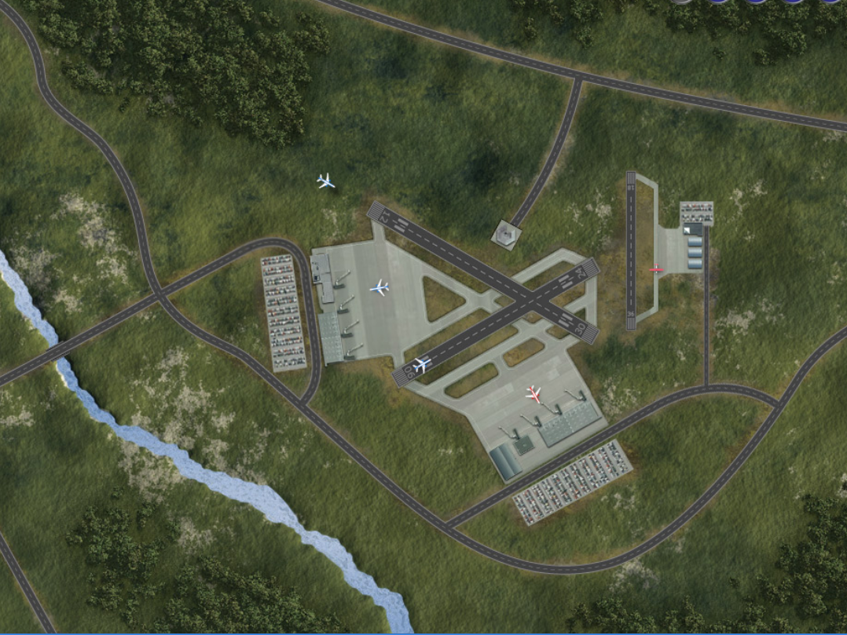
Aerodrome Control

Slide 29









Approach Control
Metering
Merging
Sequencing
Spacing

Slide 30
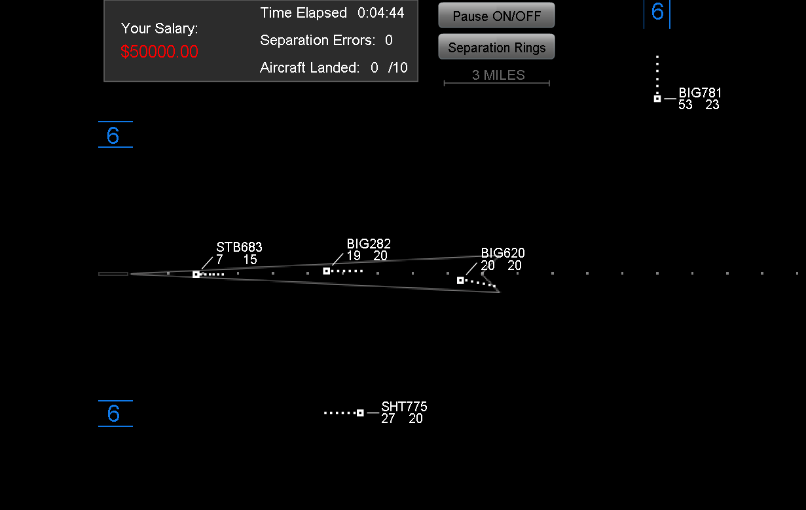
Approach Control

Slide 31
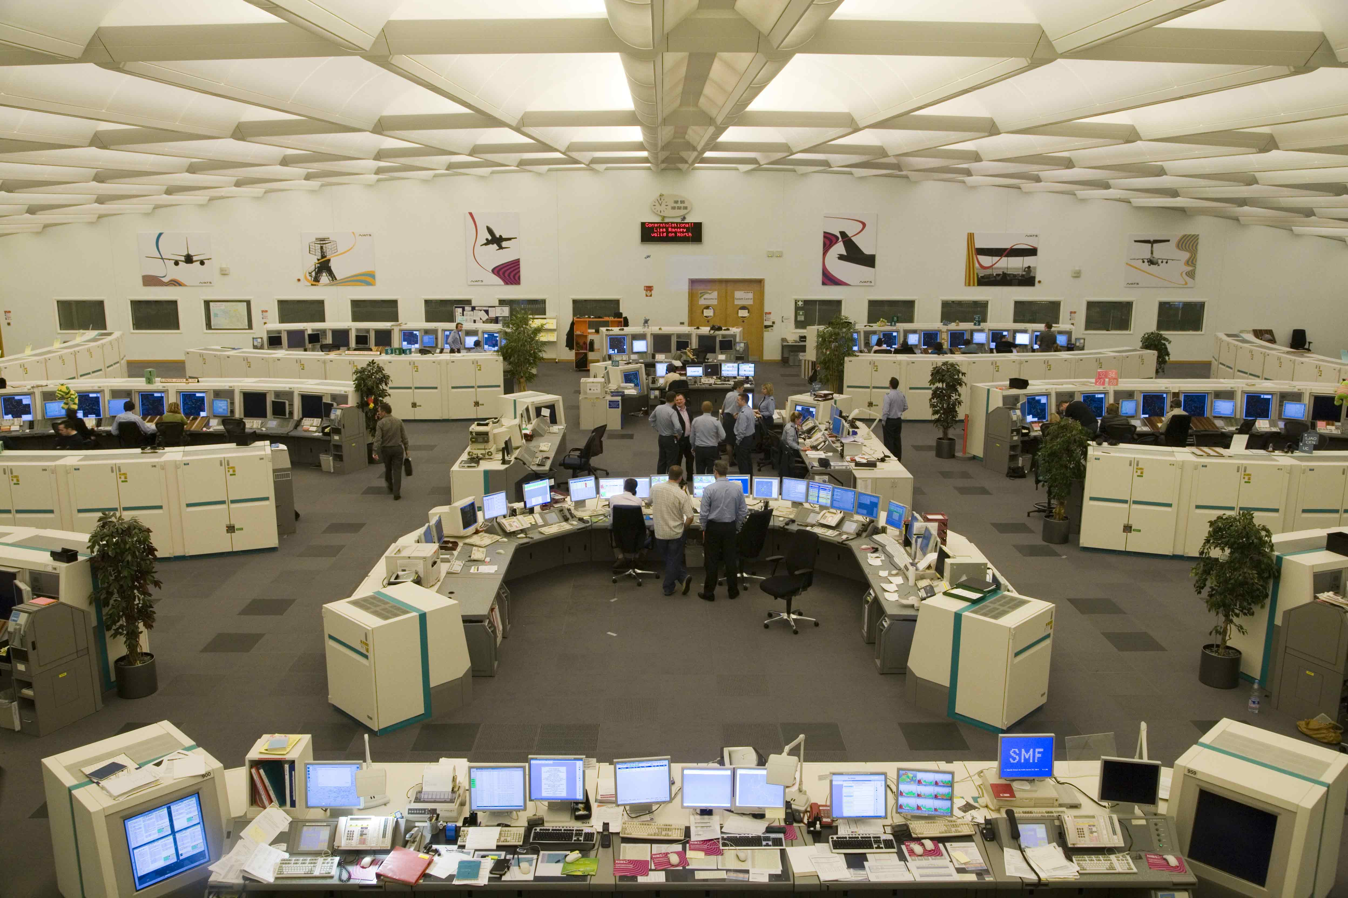
Area Control

Slide 32
Flight Information Service
SIGMET and AIRMET information;
information concerning pre-eruption volcanic activity, volcanic eruptions and volcanic ash clouds;
information concerning the release into the atmosphere of radioactive materials or toxic chemicals;
information on changes in the serviceability of navigation aids;
information on changes in condition of aerodromes and associated facilities, including information on the state of the aerodrome movement areas when they are affected by snow, ice or significant depth of water;
information on unmanned free balloons;
weather conditions reported or forecast at departure, destination and alternate aerodromes;
collision hazards, to aircraft operating in airspace Classes C, D, E, F and G;
for flight over water areas, in so far as practicable and when requested by a pilot, any available information such as radio call sign, position, true track, speed, etc., of surface vessels in the area.

Slide 33
Flight Information Broadcasts
OFIS- Operational Flight Information Service
ATIS – Automatic Terminal Information Service
VOLMET – Meteorological information for aircraft in flight

Slide 34
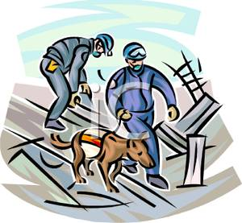
Alerting Service
Three phases
Uncertainty phase
Alert phase
Distress phase

Slide 35
Alerting Service
Uncertainty phase when:
no communication has been received from an aircraft within a period of 30 minutes after the time a communication should have been received, or from the time an unsuccessful attempt to establish communication with such aircraft was first made, whichever is the earlier, or when
an aircraft fails to arrive within 30 minutes of the estimated time of arrival last notified to or estimated by air traffic services units, whichever is the later,

Slide 36
Alerting Service
Alert phase when:
following the uncertainty phase, subsequent attempts to establish communication with the aircraft or inquiries to other relevant sources have failed to reveal any news of the aircraft, or when
an aircraft has been cleared to land and fails to land within 5 minutes of the estimated time of landing and communication has not been re-established with the aircraft, or when
information has been received which indicates that the operating efficiency of the aircraft has been impaired, but not to the extent that a forced landing is likely, except when evidence exists that would allay apprehension as to the safety of the aircraft and its occupants, or when
an aircraft is known or believed to be the subject of unlawful interference.

Slide 37
Alerting Service
Distress phase when:
following the alert phase, further unsuccessful attempts to establish communication with the aircraft and more widespread unsuccessful inquiries point to the probability that the aircraft is in distress, or when
the fuel on board is considered to be exhausted, or to be insufficient to enable the aircraft to reach safety, or when
information is received which indicates that the operating efficiency of the aircraft has been impaired to the extent that a forced landing is likely, or when
information is received or it is reasonably certain that the aircraft is about to make or has made a forced landing.

Slide 38
Questions
What are the objectives of ATS
What are the types of separation
What is the determining factor on wake turbulence?
Under what circumstances can an arriving aircraft be permitted to land?
Under what circumstances can a departing aircraft be permitted to take off?
What the five legs of an aerodrome traffic pattern
What are the main functions of an approach controller?
What is the objective of Flight Information Service?
What is the objective of Alerting Service?
What are the three phases for alerting service?

